Slide 1

VEMU INSTITUTE OF TECHNOLOGY
DEPARTMENT OF MASTER OF COMPUTER APLICATIONS
FOOD DEMAND DYNAMICS WITH ADVANCED REGRESSION TECHNIQUES AND DEEP LEARNING MODELS
PRESENTED BY
Umamahesh Kotteti,
R.No : 224M1F0036,
Dept of MCA,
VEMU IT.
UNDER THE GUIDANCE OF
Niranjan Kalikiri, M.Tech
Professor,
Dept of MCA,
VEMU IT.

Slide 2
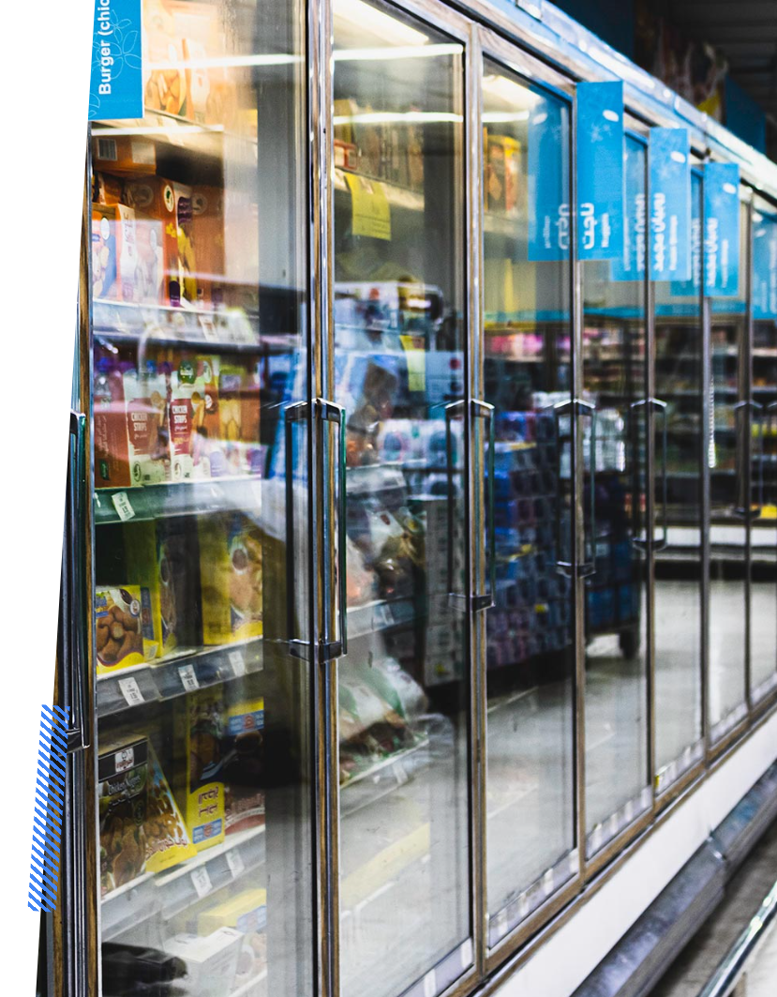
Food Demand Dynamics with Advanced Regression Techniques and Deep Learning Models
Abstract :
This project focuses on the critical task of demand forecasting in the food industry, where product shelf life is limited, and mismanaged inventory can lead to significant losses.
Leveraging machine learning and deep learning techniques, the study analyzes the 'Food Demand Forecasting' dataset from Genpact, examining the impact of various factors on demand and identifying influential features.
The project conducts a comparative analysis of seven regression models, including Random Forest, Gradient Boosting, LightGBM, XGBoost, Cat Boost, LSTM, and Bidirectional LSTM.
Results highlight the effectiveness of deep learning models, with LSTM outperforming others, achieving low error rates (RMSLE: 0.28, RMSE: 18.83, MAPE: 6.56%, MAE: 14.18). This research underscores the potential of deep learning for accurate demand forecasting in the food industry.

Slide 3

Objective
The objective is to utilize machine learning and deep learning methods for accurate food demand forecasting, analyzing factors affecting demand, comparing regressors, and highlighting the superior performance of LSTM in predicting orders.

Slide 4

Introduction :
In today’s competitive market, companies focus heavily on demand forecasting for efficient demand-supply chain management.
Inaccurate forecasts risk high inventory causing wastage or insufficient stock leading to customer loss.
Forecast accuracy impacts various departments financial, marketing, purchasing, and operations shaping strategies, investment plans, and resource management.
Accurate forecasts are pivotal for profitability, cost estimation, and strategic planning.
This study examines machine learning models using the 'Food Demand Forecasting' dataset to enhance accuracy, benefiting companies in better planning, reducing waste, and improving demand-supply chain efficiency.

Slide 5
Literature Survey :
S.no | Year | Authors | Title | Results
1 | 2009 | P.Veiga | Analysis of quantitative methods of demand forecasting: Comparative study and financial performance. | compare the ARIMA and Holt- Winters models based on MAPE and U-Theil, applied to demand forecasting of a time series.
2 | 2004 | C.Holt | Forecasting seasonals and trends by exponentially weighted moving averages. | The paper provides a systematic development of the forecasting expressions for exponential weighted moving averages.

Slide 6
S.no | Year | Authors | Title | Outcomes
3 | 2021 | H.Hewamalage, C. Bergmeir, and K. Bandara | Recurrent neural networks for time series forecasting: Current status and future directions. | derived conclusions regarding general data preprocessing best practices, hyperparameter configurations, and the best RNN architectures, recurrent units, and optimizers.
4 | 2021 | M.Markiewicz, and A.Wyłomańska | Time series forecasting: Problem of heavy-tailed distributed noise. | Dealt with heavy-tailed distributed noise and successfully forecasted time series.

Slide 7
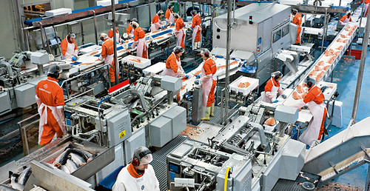
Existing system :
Accurate forecasting is become necessity in food industry to meet demand supply requirements. Many food products has shelf life and if demand forecast is not accurate and then either short life products will be wasted or in some scenarios it goes for shortage. Many deep learning or machine learning algorithms was introduced for accurate forecasting but they lack support of Time series or LAG data.

Slide 8
Disadvantages :
Limited Lag Data
Time Series Data Exclusion
Insufficient Shelf-Life Prediction
Insufficient Forecasting Techniques

Slide 9

Proposed System :
To overcome from this problem author of this project extracting LAG data from dataset and then assigning weight to target variable by using alpha values as 0.5 and products which are recent or high in demand will have high weight values.
Time series data is extracted from entire dataset for 10 week periods and then forecasting will happen for next 10 weeks. Extracted lag data will get trained with various ML and DL algorithms such as Random Forest, Gradient Boosting, XGBOOST, CATBOOST, LIGHT GBM, LSTM and BI-LSTM.
Each algorithm performance is evaluated in terms of RMSE (root mean square error), MAE (mean absolute error), MAPE (mean absolute percentage error) and RMSLE. All this metrics refers to difference between original values and predicted values so the lower the difference the better is the algorithm. Among all algorithms LSTM is giving less MAE and RMSE error rate.

Slide 10
Advantages :
Comparison of Various Regression Techniques. | Comprehensive Dataset Analysis Methods. | Accurate Forecasting.
Performance Metrics Validation Results. | Time-Dependent Data Handling Advancements. | Deep Learning Model Superiority.

Slide 11

Requirements :
Hardware
Operating System : Windows 10 or 11
RAM : 8GB or above
Hard Disc / SSD : 500 GB or above
Processor : Intel 3rd Gen or above
Software
Python 3.7 or Latest
Jupyter Notebook

Slide 12
Use Case Diagram

Slide 13
Sequence Diagram

Slide 14
Class Diagram

Slide 15
Collaboration Diagram

Slide 16
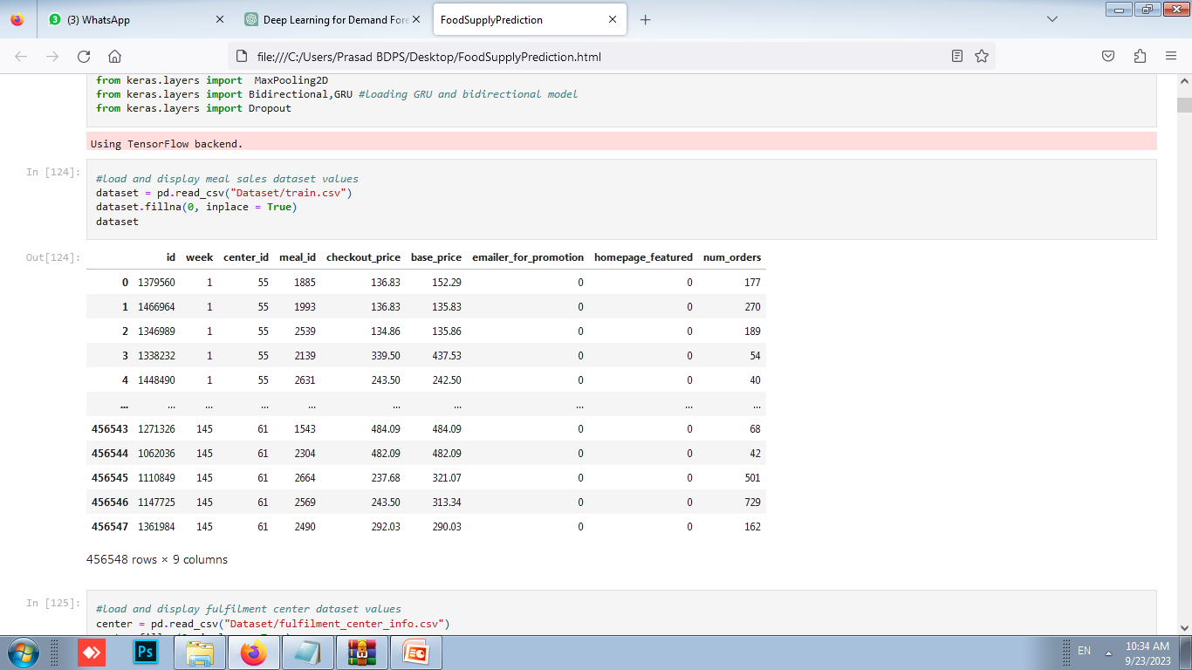
Results

Slide 17
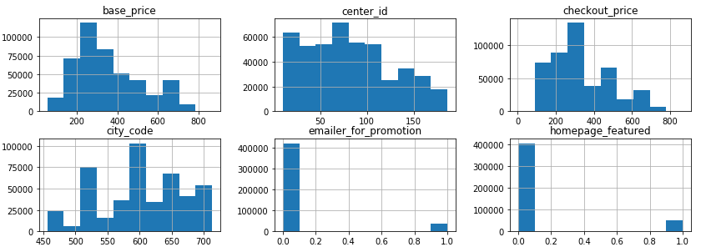
Results
#Features distribution graph

Slide 18
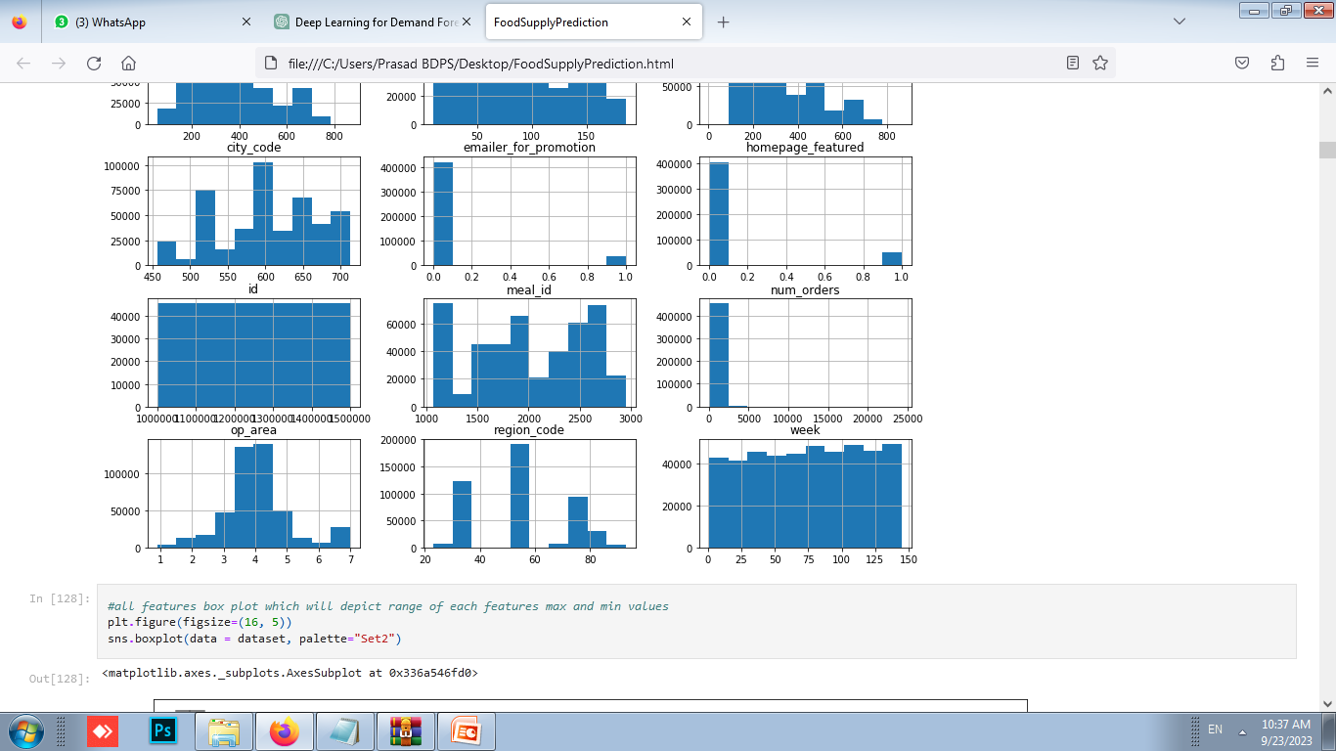
#Features distribution graph

Slide 19
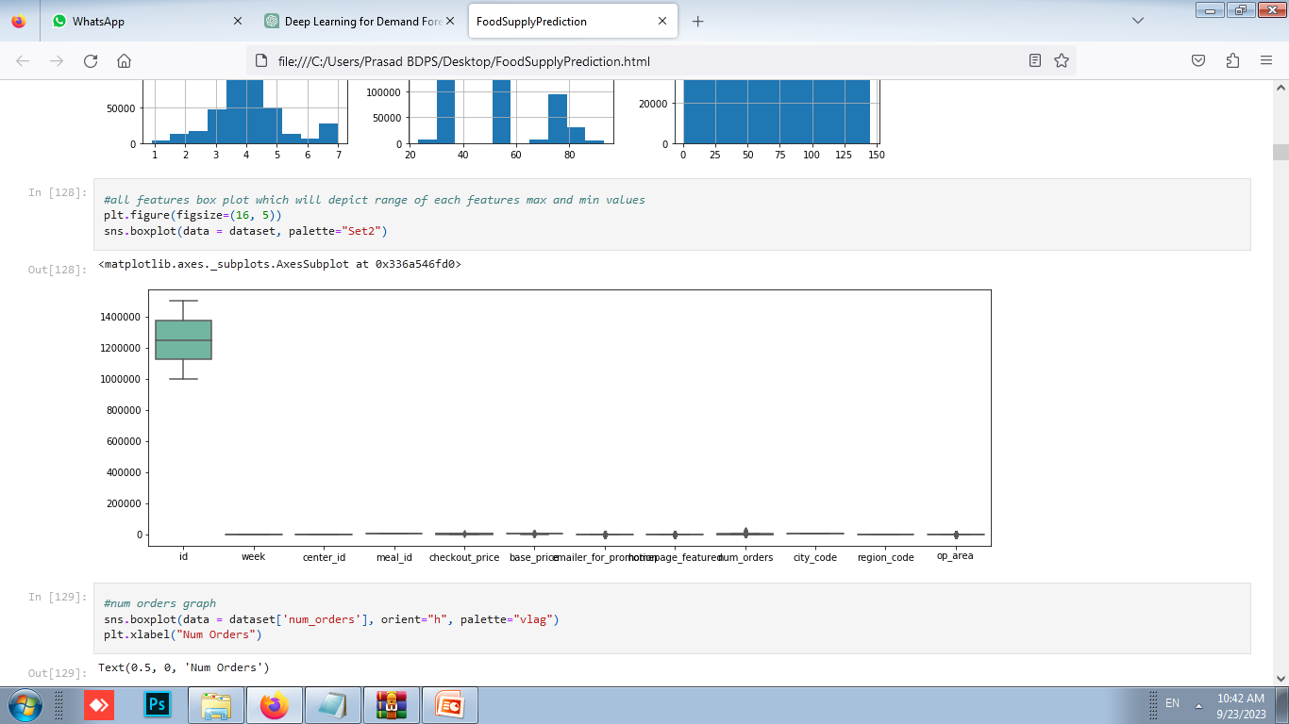
#All features box plot which will depict range of each features max and min values

Slide 20
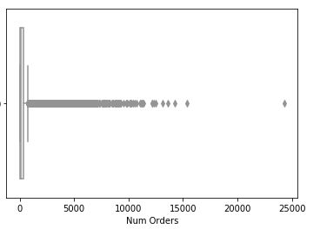
#Num orders graph

Slide 21
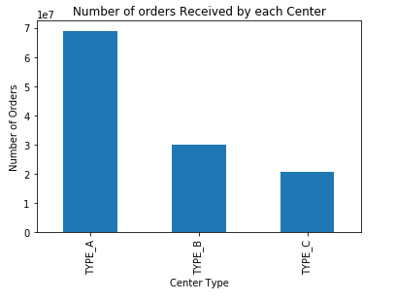

Slide 22
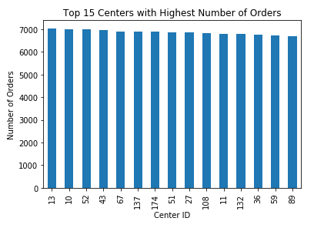

Slide 23
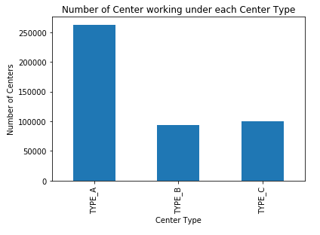

Slide 24
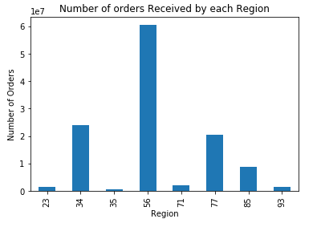

Slide 25
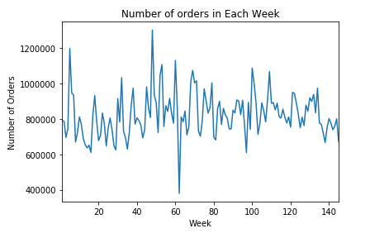

Slide 26
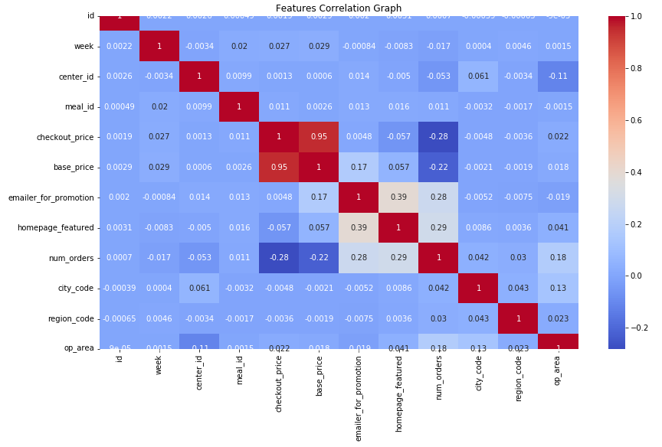

Slide 27
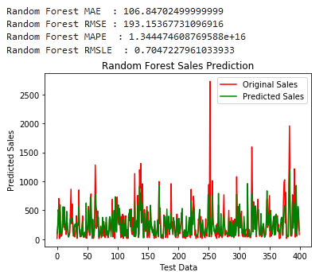

Slide 28
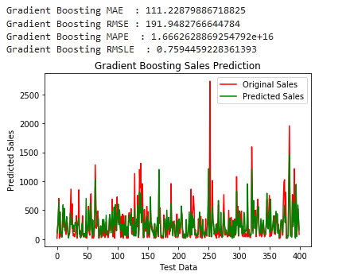

Slide 29
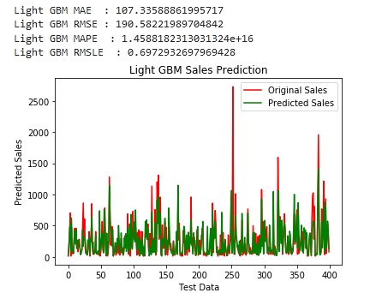

Slide 30
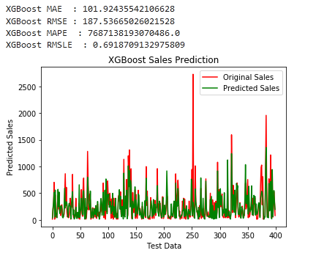

Slide 31
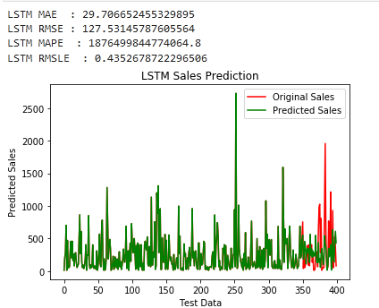

Slide 32
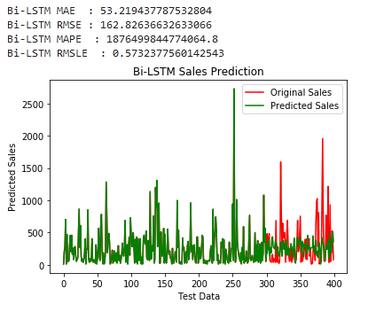

Slide 33
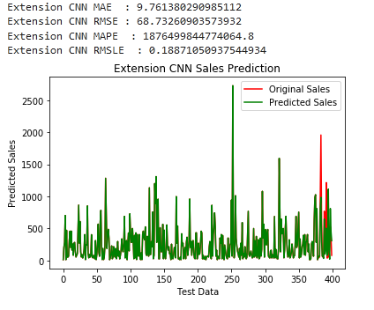

Slide 34
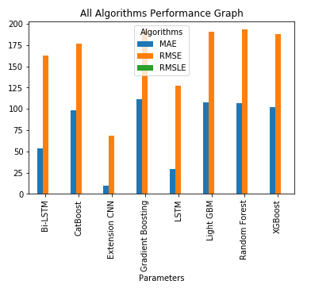

Slide 35
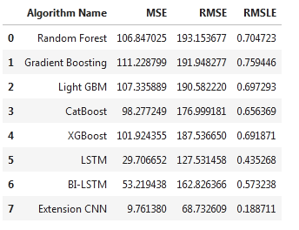

Slide 36
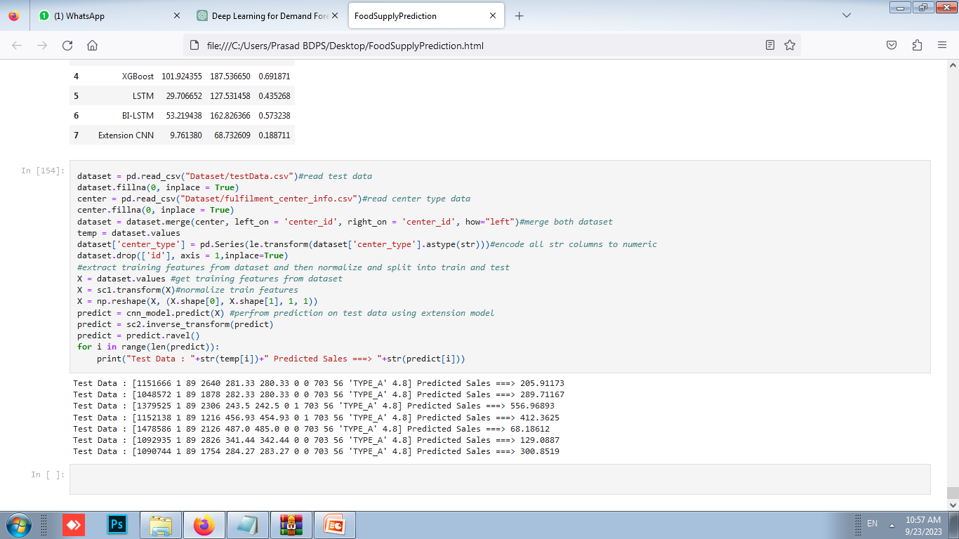
Predicted Sales

Slide 37
Future Enhancements
1. Integration of Real-Time Data: Utilize IoT devices, sensors, and social media analytics to incorporate real-time data for improved accuracy.
2. Advanced AI Techniques: Implement reinforcement learning and GANs to dynamically adjust strategies and simulate market scenarios.
3. Personalization: Use machine learning for hyper-personalized marketing and behavior analysis to predict demand more accurately.
4. Sustainable Forecasting: Incorporate environmental impact analysis and ensure ethical AI practices in forecasting models.
5. Advanced Computational Techniques: Explore quantum and edge computing to handle complex datasets and enable real-time forecasting.

Slide 38
Conclusion
Accurate forecasting is paramount in the food industry to efficiently manage supply and demand, especially for
perishable goods. Despite the introduction of various machine learning and deep learning algorithms, many lacked robust support for time series data. To address this limitation, the author proposed extracting lag data and assigning weighted values to target variables using alpha values. Through rigorous evaluation using metrics like RMSE, MAE, MAPE, and RMSLE, LSTM emerged as the most effective algorithm, closely followed by BI-LSTM. Additionally, the extension of using CNN2D yielded promising results, significantly improving forecasting accuracy. These findings underscore the importance of leveraging advanced algorithms to optimize food supply chain management.

Slide 39
References
[1] V. K. Shrivastava, A. Shrivastava, N. Sharma, S. N. Mohanty, and C. R. Pattanaik, ‘‘Deep learning model for temperature prediction: A case study in New Delhi,’’ J. Forecasting, vol. 43, no. 1, Feb. 2023, doi: 10.1002/for.2966.
[2] I. Shah, F. Jan, and S. Ali, ‘‘Functional data approach for short-term electricity demand forecasting,’’ Math. Problems Eng., vol. 2022, Jun. 2022, Art.no. 6709779
[3] Y. Zhang, L. Wang, X. Chen, Y. Liu, S. Wang, and L. Wang, ‘‘Prediction of winter wheat yield at county level in China using ensemble learning,’’ Prog. Phys. Geogr., Earth Environ., vol. 46, no. 5, pp. 676–696, Oct. 2022.
[4] I. Shah, H. Iftikhar, and S. Ali, ‘‘Modeling and forecasting electricity demand and prices: A comparison of alternative approaches,’’ J. Math., vol. 2022, Jul. 2022, Art. no. 3581037.

Slide 40
Thank You

